Slide 1

Object Oriented Design & Programming (21CSC101T)
Arvind Kharwal

Slide 2
MinGW

Slide 3
MinGW stands for Minimalist GNU for Windows. It is a free and open source software development environment to create Microsoft Windows applications.
MinGW does not rely on third-party C runtime dynamic-link library (DLL) files

Slide 4
MinGW includes the followings:
A port of the GNU Compiler Collection (GCC)
GNU Binutils for Windows (assembler, linker, archive manager)
A set of freely distributable Windows specific header files
Static import libraries which enable the use of the Windows API
Windows native build of the GNU Project's GNU Debugger
Other miscellaneous utilities.

Slide 5
How to install MinGW?

Slide 6
Download the application from https://osdn.net.

Slide 7
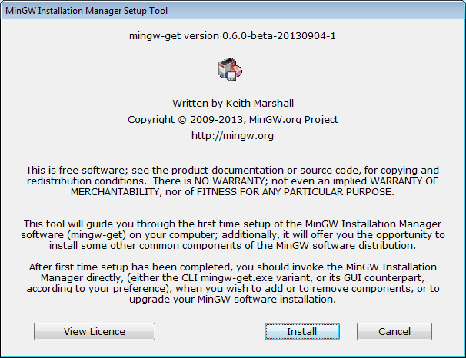

Slide 8
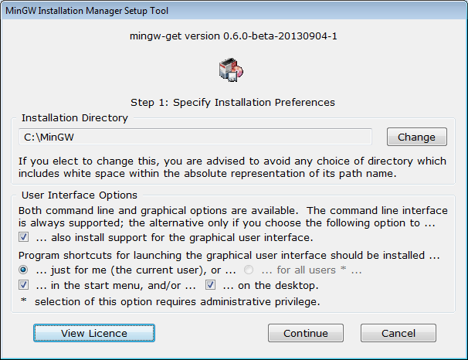

Slide 9
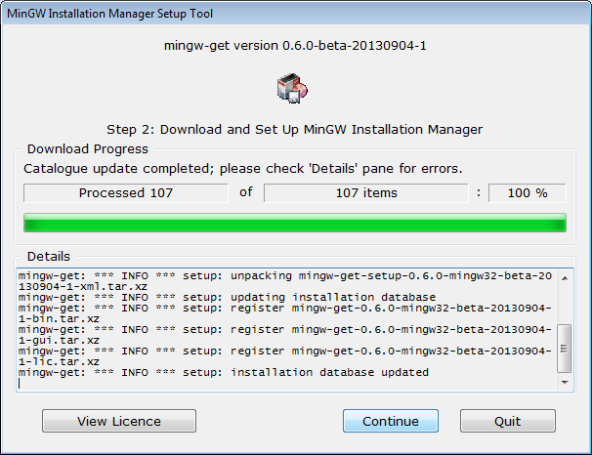

Slide 10
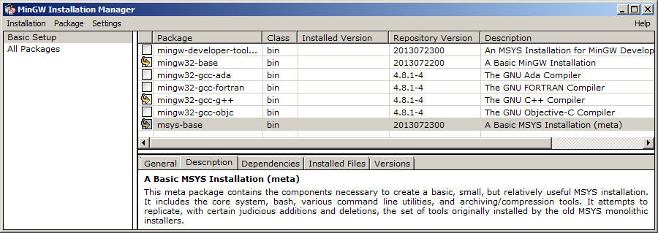

Slide 11
Set Path for MinGw
1. Copy this path -> C:\MinGW\bin
2. Right click on This PC.
3. Click on Properties.
4. Click on Advanced System Settings.
5. Click on Environment Variables.
6. Go to the System Variables Section
7. Now choose path -> edit
8. Click on new & paste the path on MinGW

Slide 12
Thank You

